Slide 1
Operating Systems 2
Processes

Slide 2
Introduction
What is a process….
The process scheduler
The process control Block; elements of the PCB
Creating process in Unix/Linux
fork() command
Wait() command
exec commands
Multiprocessing system: scheduling; interprocess communication (synchronisation, asynchronous)

Slide 3
Some revision
Simple system
Single user
One processor: busy only when executing the user’s job or system software
Multiprogramming environment: multiple processes competing to be run by a single CPU
Requires fair and efficient CPU allocation for each job

Slide 4
Definitions
Processor (CPU)
Performs calculations and executes programs
Program (job)
Inactive unit, e.g., “an application stored on a secondary storage disk”
Unit of work submitted by the user
Process (task)
A single instance of an executable program
Active entity that Requires resources (such as processor, special registers, its own memory space, and context data or process control box (PCB) ) to perform its function

Slide 5
Definitions (cont’d.)
Thread (of control)
Portion of a process; a process can have multiple threads of control
A process is equivalent to a program while threads are equivalent to modules/methods within the program
A thread is executed “independently” within the parent process;

Slide 6
Definitions
Multiprogramming
Processor allocated to each job/process/thread for a time period
E.g. two or more programs (jobs). The jobs are independent of one another.
Executing job 1 and job 2 is in a queue. At an appropriate time (i/o instruction) an interrupt is evoked and the position of execution is noted. Then job 2 is executed and either at an interrupt or when finished job 1 begins from point where it stopped executing
In a single processor the jobs are interleaved (run concurrently)
In multiprocessor system can be run in parallel

Slide 7
Definitions (cont’d.)
Interrupt
Call for help (i/o instruction) (job 1)
Activates higher-priority program (job 2)
Context switch
Saving job processing information when interrupted
Load next job
Interrupt can be invoked under a number of conditions (pre-emptive or non-preemptive)
Single processor
May be shared by several jobs (processes)
Requires scheduling policy and scheduling algorithm
The policies can be non-preemptive or preemptive

Slide 8
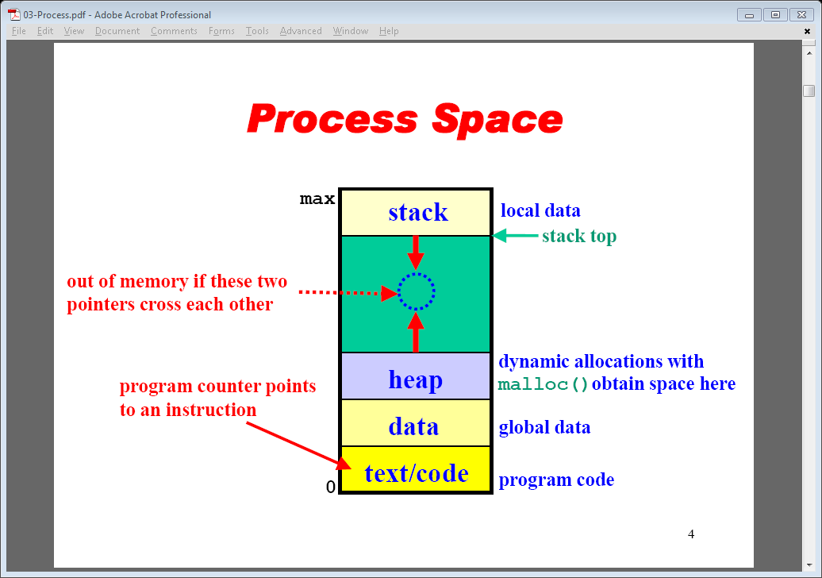
Process Space

Slide 9
Scheduling Submanagers
Processor Manager: composite of two submanagers
Job Scheduler and Process Scheduler: hierarchical scheduling system
Job Scheduler: higher-level scheduler
Job scheduling responsibilities
Job initiation based on certain criteria related to priority that essentially tries to utilise all resources efficiently
Process Scheduler: lower-level scheduler
Process scheduling responsibilities
Determines execution steps
Process scheduling: based on certain criteria (e.g. priority)

Slide 10
Scheduling Submanagers (cont'd.)
Job Scheduler functions
Selects incoming job from queue
Places in process queue
Decides on job initiation criteria
Process scheduling algorithm and priority
Goal
Sequence jobs
Efficient system resource utilization
Balance I/O interaction and computation
Keep most system components busy most of time

Slide 11
Process Scheduler
Process Scheduler functions
Determines job to get CPU resource
When and how long
Decides interrupt processing
Determines queues for job movement during execution
Recognizes job conclusion
Determines job termination
Lower-level scheduler in the hierarchy
Assigns CPU to execute individual actions: jobs placed on READY queue by the Job Scheduler

Slide 12
Process Scheduler (cont'd.)
Exploits common computer program traits
Programs alternate between two cycles
CPU
I/O cycles
General tendencies
I/O-bound job
Many brief CPU cycles and long I/O cycles (printing documents)
CPU-bound job
Many long CPU cycles and shorter I/O cycles ( a complex maths calculation)

Slide 13
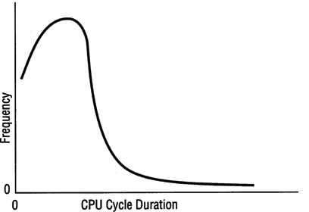
Process Scheduler (cont'd.)
(figure 4.1)
Distribution of CPU cycle times. This distribution shows a greater number of jobs requesting short CPU cycles (the frequency peaks close to the low end of the CPU cycle axis), and fewer jobs requesting long CPU cycles. © Cengage Learning 2014

Slide 14
Job and Process States
Status changes: as a job or process moves through the system
HOLD and placed in a queue (sometimes a priority queue
READY (job begins processing if enough resources available)
WAITING (can not continue until specific resource available e.g. i/o request
RUNNING: processing
FINISHED

Slide 15
Process Management
The entire state of the process at any instant is contained in its context (process control block)
Notes:
Figure 2.8 indicates a way in which processes may be managed. Two processes,
A and B, exist in portions of main memory. That is, a block of memory is
allocated to each process that contains the program, data, and context information.
Each process is recorded in a process list built and maintained by the OS. The
process list contains one entry for each process, which includes a pointer to the
location of the block of memory that contains the process. The entry may also
include part or all of the execution context of the process. The remainder of the
execution context is stored elsewhere, perhaps with the process itself (as indicated
in Figure 2.8 ) or frequently in a separate region of memory. The process index
register contains the index into the process list of the process currently controlling
the processor. The program counter points to the next instruction in that process
to be executed. The base and limit registers define the region in memory occupied
by the process: The base register is the starting address of the region of memory
and the limit is the size of the region (in bytes or words). The program counter and
all data references are interpreted relative to the base register and must not exceed
the value in the limit register. This prevents interprocess interference.
In Figure 2.8 , the process index register indicates that process B is executing.
Process A was previously executing but has been temporarily interrupted. The
contents of all the registers at the moment of A’s interruption were recorded in its
execution context. Later, the OS can perform a process switch and resume execution
of process A. The process switch consists of storing the context of B and restoring
the context of A. When the program counter is loaded with a value pointing into A’s
program area, process A will automatically resume execution.

Slide 16
Fields of a process control block (PCB)
Process id. A unique number assigned when job enters the system
Process status: hold, ready, running waiting
Process state (all information to indicate current state of the job
Status: current instruction counter
register contents; e.g. accumulator register
Main memory: where the job is stored or refer to process management table (P.M.T.)
Resources: hardware (disk) or files
Priority: determines when the job will run
Accounting: what resources the job used and for how long

Slide 17
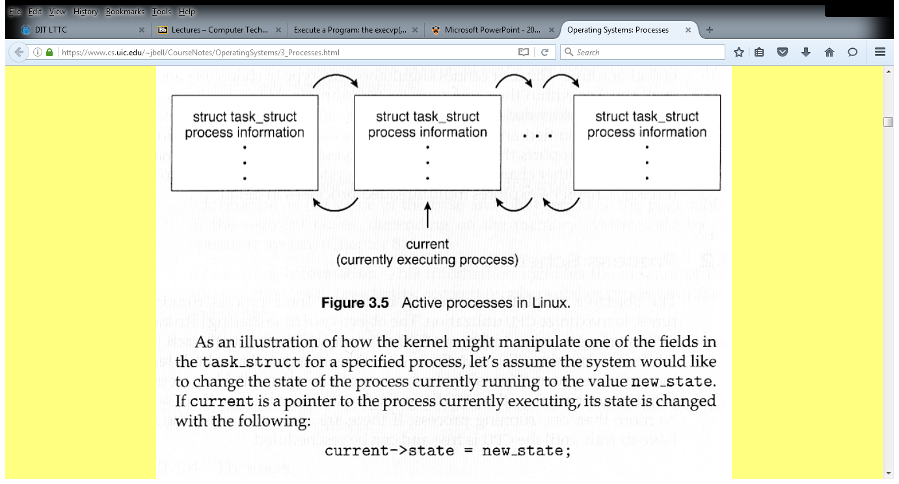
Managing the process list
Task_struct is linux implementation of the PCB

Slide 18
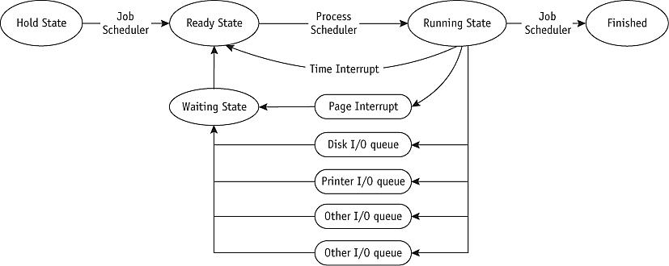
Processing states (Control Block) and Queuing (cont'd.)
(figure 4.5)
Queuing paths from HOLD to FINISHED. The Job and Processor schedulers release the resources when the job leaves the RUNNING state.

Slide 19
Scheduling Policies
Multiprogramming environment
More jobs than resources at any given time
Operating system pre-scheduling task
Resolve three system limitations
Finite number of resources (disk drives, printers, tape drives)
Some resources cannot be shared (mutual exclusion) once allocated (printers)
Some resources require operator intervention before reassigning: mouse click / keyboard…

Slide 20
Purpose of Scheduling Policies
Good process scheduling policy criteria
Maximize throughput
Run as many jobs as possible in given amount of time
Minimize response time
Quickly turn around for interactive requests
Minimize turnaround time
Move entire job in and out of system quickly
Minimize waiting time
Move job out of READY queue quickly: limit the number of users allowed on the system

Slide 21
Scheduling Policies (cont'd.)
Good process scheduling policy criteria (cont'd.)
Maximize CPU efficiency
Keep CPU busy 100 percent of time
Ensure fairness for all jobs
Give every job equal CPU and I/O time
Final policy criteria decision lies with system designer or administrator (select a scheduling policy that maximises efficiency of system resources)

Slide 22
Scheduling Policies (cont'd.)
Problem
Job claims CPU for very long time before I/O request issued
Builds up READY queue and empties I/O queues
Creates unacceptable system imbalance
Corrective measure
Interrupt
Used by Process Scheduler upon predetermined expiration of time slice
Current job activity suspended
Reschedules job into READY queue

Slide 23
Scheduling Policies (cont'd.)
Types of scheduling policies (will be referred to in process scheduling lecture)
Preemptive
Used in time-sharing environments
Interrupts job processing after a specific amount of time if there has been no other interrupts
Transfers CPU to another job (round robin)
Non-preemptive
Functions without “external” interrupts
a job or process remains in a running state until interrupted by internal interrupts e.g. I/O request: used in batch systems

Slide 24
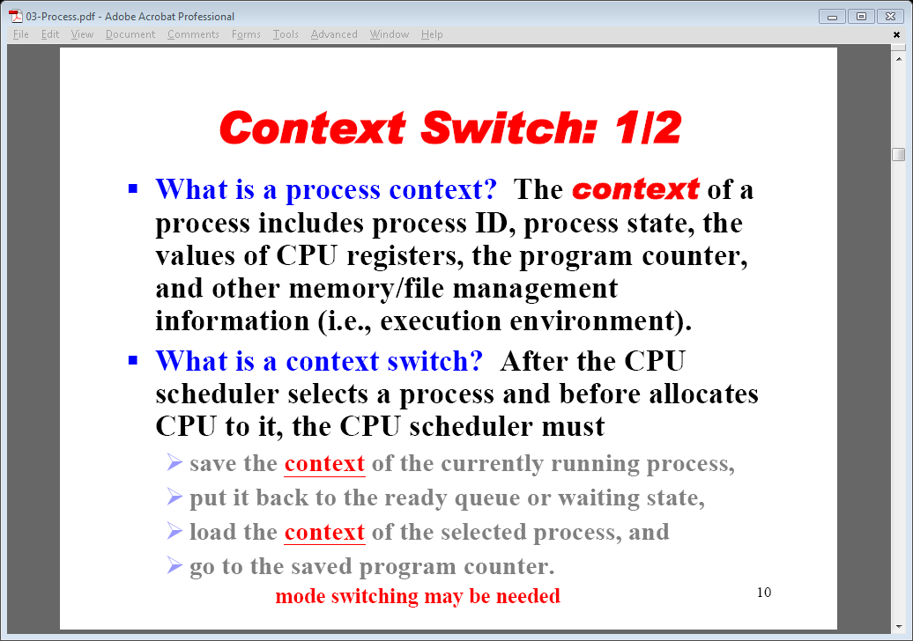
Re-scheduling a process

Slide 25
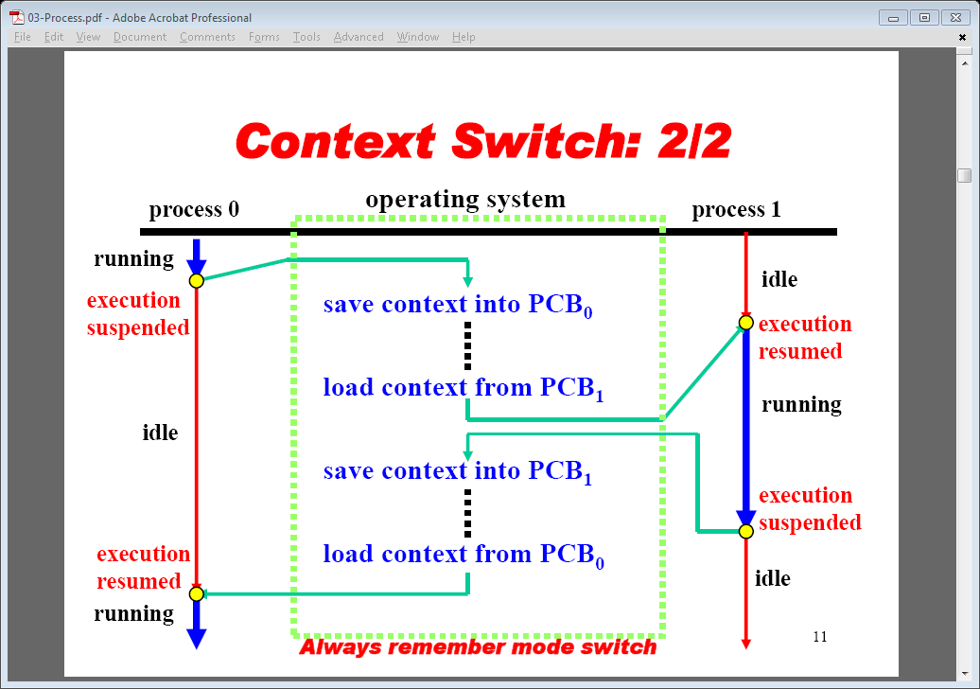
Illustration of context switching

Slide 26
Process in Unix
The ps command shows basic information about the PCBs
PID time DESCRIPTION (CMD)
e.g. the man ps shows other command line arugments; e.g.
%cpu %CPU cpu utilization of the process in "##.#" format.
Currently, it is the CPU time used divided by the time the
process has been running (cputime/realtime ratio),
expressed as a percentage. It will not add up to 100%
unless you are lucky. (alias pcpu).
%mem %MEM ratio of the process's resident set size to the physical
memory on the machine, expressed as a percentage.
(alias pmem).

Slide 27
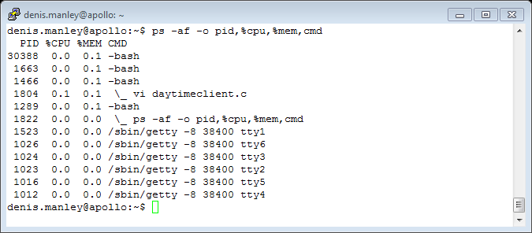
Example more detailed ps command

Slide 28
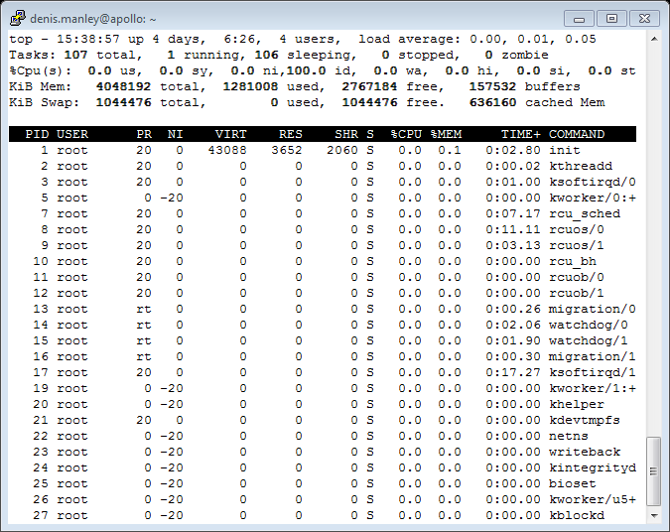
Top commands in linux: list of processes

Slide 29
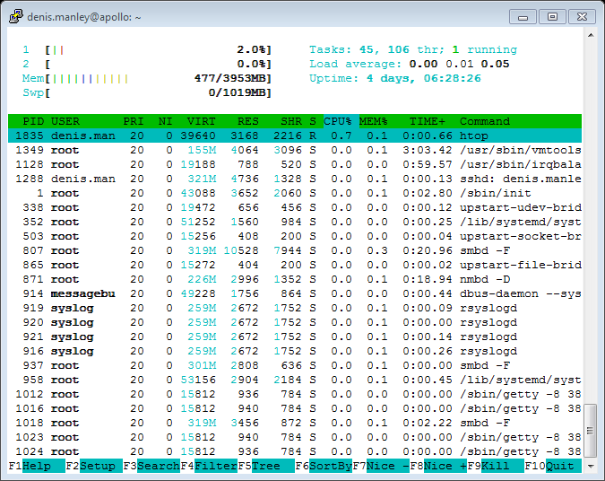
htop command in linux

Slide 30
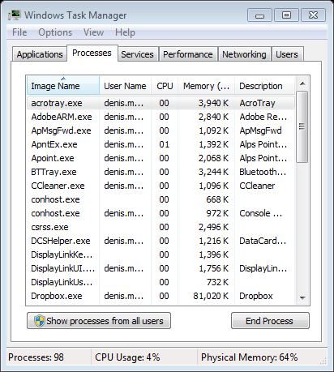
Process details in windows

Slide 31
Process Creation
Address space
Child duplicate of parent
Child has a program (process) loaded into it
UNIX/Linux examples
The fork() system call in Unix creates a new process. After a successful fork() call, two copies of the original code will be running. In the original process (the parent) the return value of fork() will be the process ID of the child. In the new child process the return value of fork() will be 0

Slide 32
Process Creation: Unix
In Unix, processes are created using fork()
Creates and initializes a PCB and creates a new address space
Initializes the address space with a copy of the entire contents of the address space of the parent
Initializes the kernel resources to point to the resources used by parent (e.g., open files)
Places the child PCB on the ready queue
Fork returns twice: Returns the child’s PID to the parent, “0” to the child

Slide 33
Synchronization
Fork()
UNIX command: generates one program from another program
Gives second program all first program attributes
code, global data, heap and stack, registers (including program counter), and open files.
Saves first program in original form
Splits program: two versions of the parent (parent and child)
Both run from statement after fork command
fork executed
“Process id” (pid) generated
Ensures each process has unique ID number

Slide 34
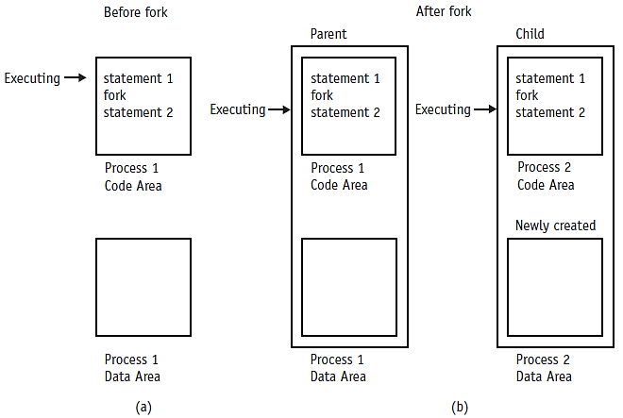
Synchronization (cont'd.)
when the fork command is received,
the parent process:
shown in (a) begets the child process shown
in (b) and Statement 2 (one of the child and one of the parent) is executed twice.
Cengage Learning 2014

Slide 35
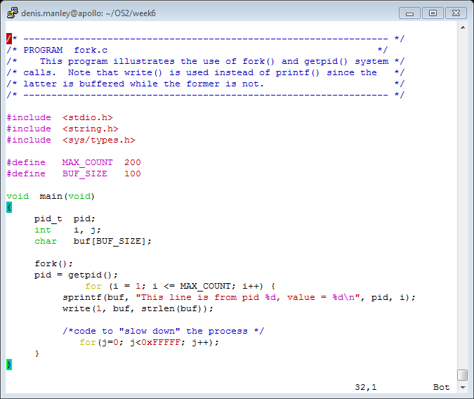
A simply program for fork: fork1.c

Slide 36
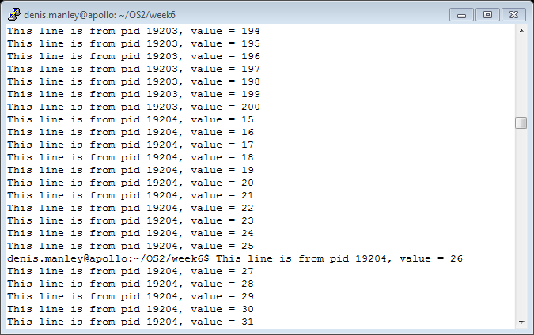
A sample run on Linux server of fork1.c

Slide 37
Sample code and output
Let us consider the following three examples to illustrate how the fork works:
Two other functions associated with the fork() and PID are
Getpid() which return the ID of the calling process
GetPPID() which returns the ID of the parent of the calling process.

Slide 38
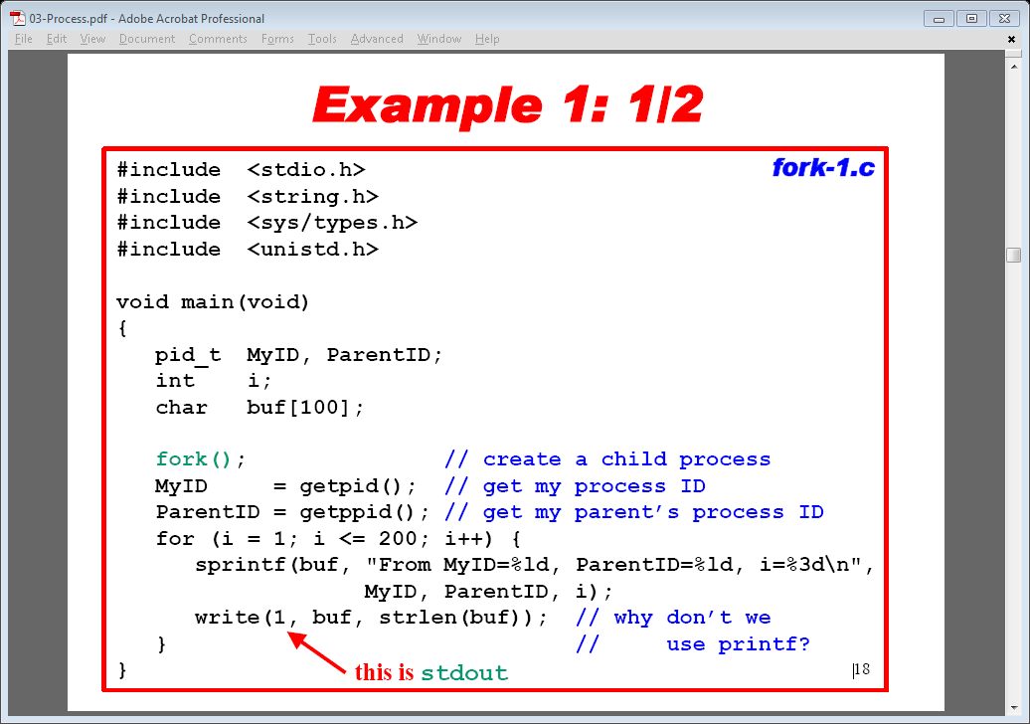
Basic Sample code.

Slide 39
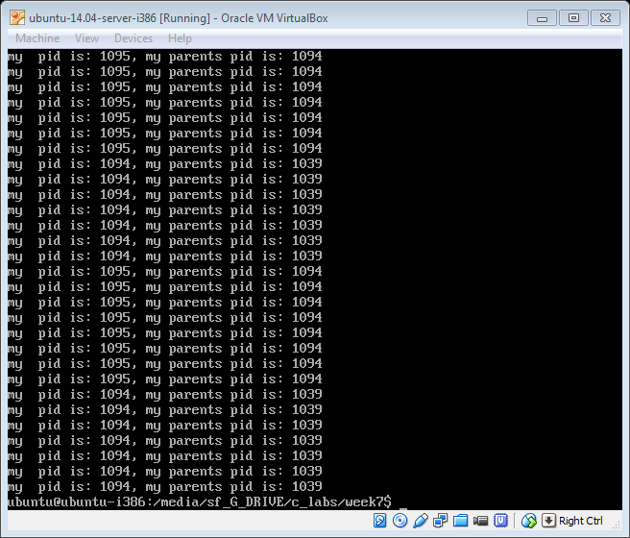
A Sample run

Slide 40
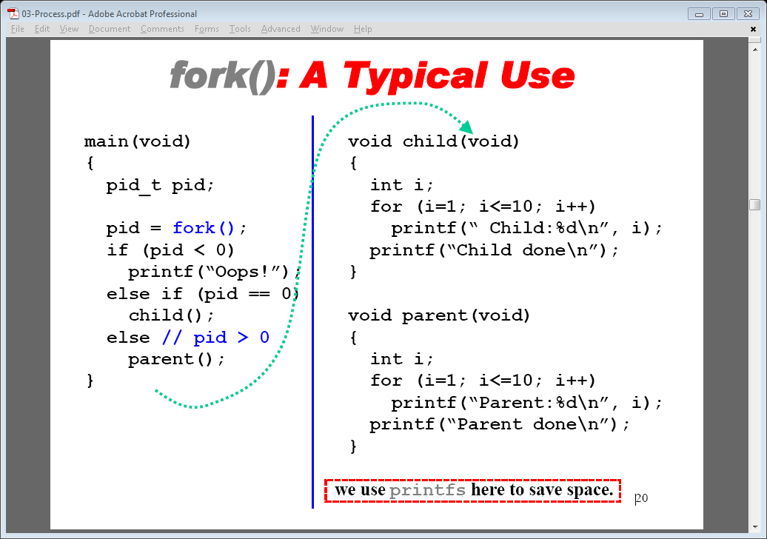
How the fork can be used .

Slide 41
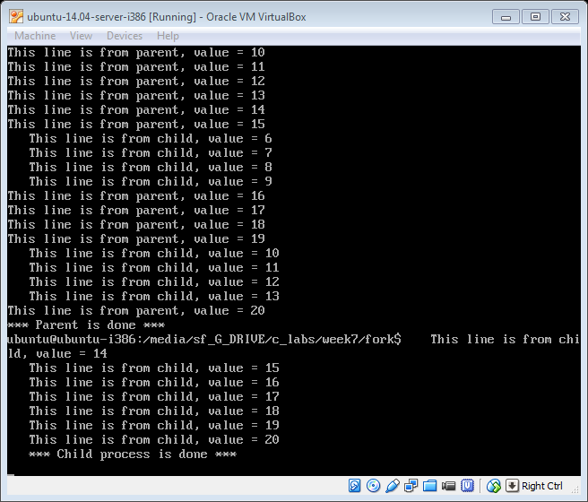
Sample output fork2.c

Slide 42
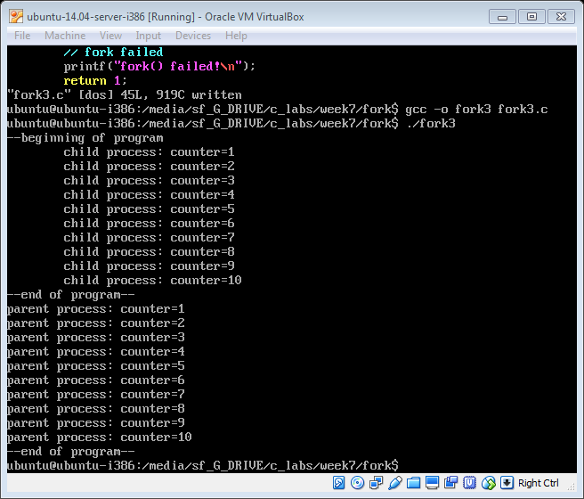
Fork3.c Controlling output of fork2.c with sleep command: program run on virtual box
I

Slide 43
Synchronisation: Wait()
Wait()
A better way to ensure “synchronisation is using the “wait()” command.
UNIX command: synchronizes process execution
Suspends parent until child finished
Program IF-THEN-ELSE structure
Controlled by pid value
pid > zero: parent process
pid = zero: child process
pid < zero: error in fork call
Modify fork3.c program to use wait instead of sleep()

Slide 44
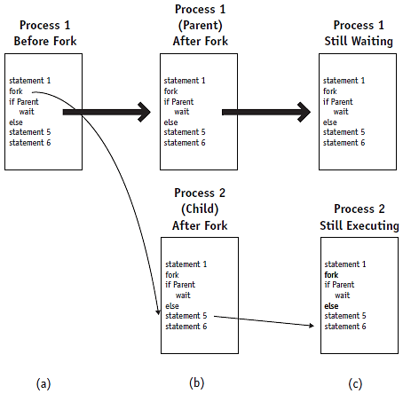
The wait command
The wait command used in conjunction with the fork command will synchronize the parent and child processes. In (a) the parent process is shown before the fork, (b) shows the parent and child after the fork, and (c) shows the parent and child during the wait.
© Cengage Learning 2014

Slide 45
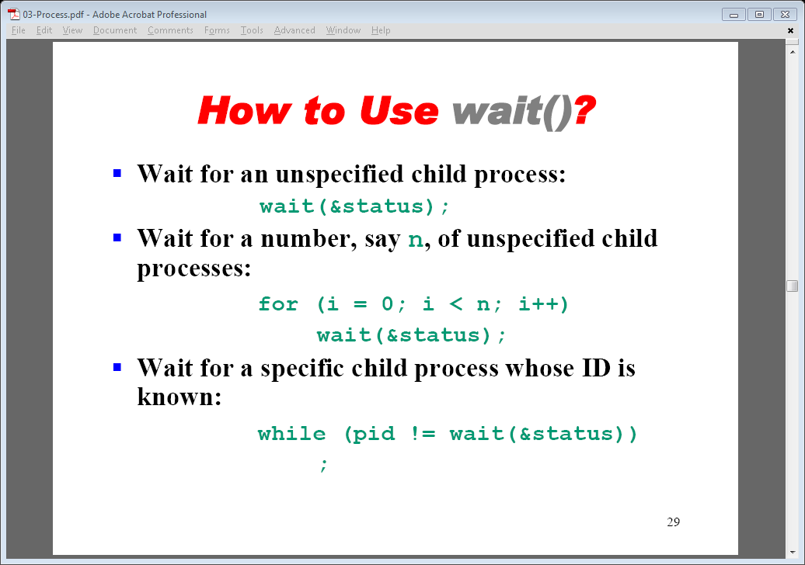
Using a wait()

Slide 46
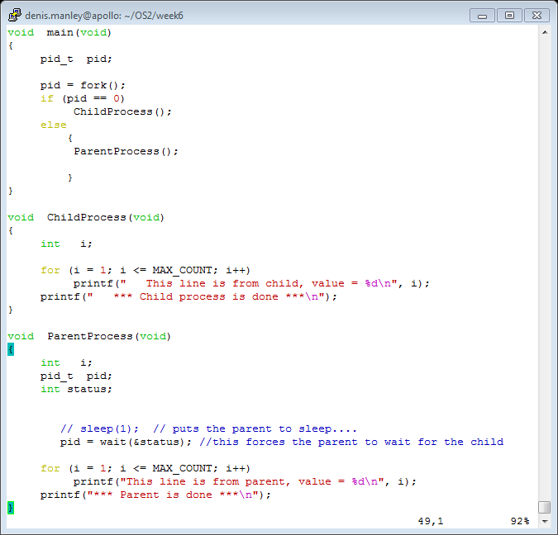
Example fork3Wait.c

Slide 47
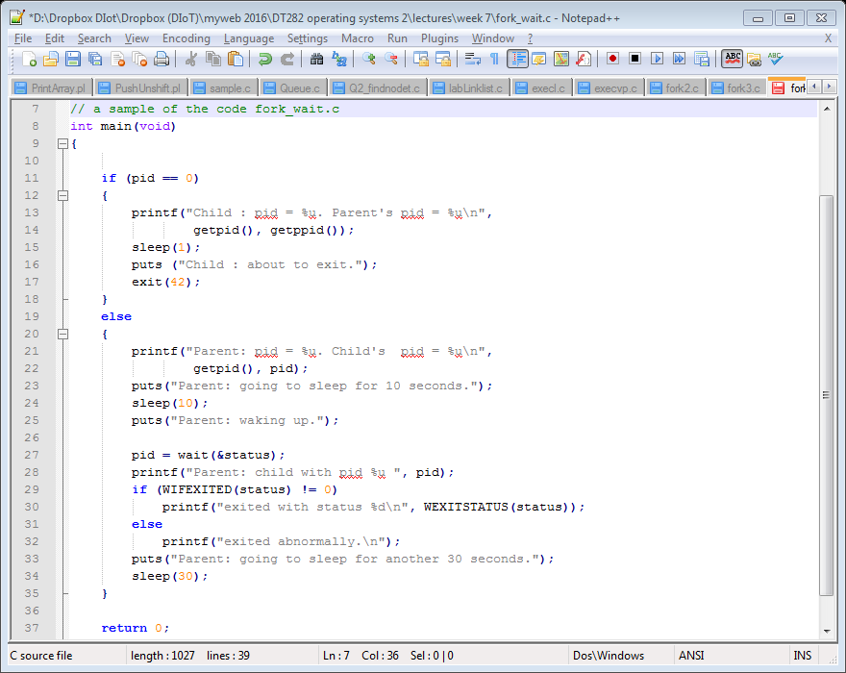
Wait example (fork_wait.c)

Slide 48
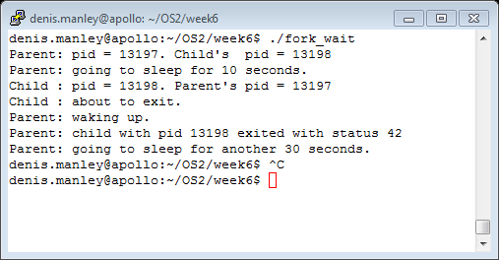
Output of fork_wait.c command
The program will take about 40 seconds to run.

Slide 49
Process Creation: Unix
How do we actually start a new program?
Use exec ((see man exec for more details)
execl, execv, execls, execlp, and execvp
Start new program execution from another program
E.g. int execvp(char *prog, char *argv[])
Stops the current process
Loads the program “prog” into the process’ address space
Initializes hardware context and args for the new program
Places the PCB onto the ready queue

Slide 50
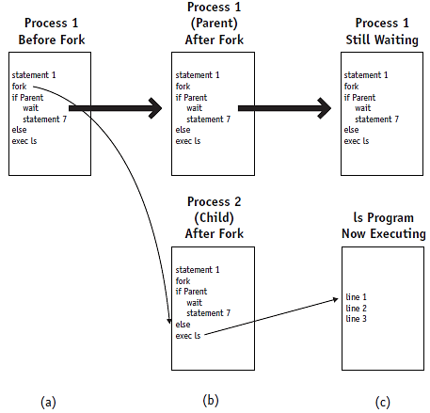
Synchronization (cont'd.)
The exec command is used, mostly, after the fork and wait combination. In (a) the parent is shown before the fork, (b) shows the parent and child after the fork, and (c) shows how the child process (Process 2) is overlaid by the ls program after the exec command.
© Cengage Learning 2014

Slide 51
The exec commands
The exec() system calls can be used after a fork() to replace the child process’ memory space with a new program
Successful exec call
Overlay second program over first
Only second program in memory
No return from successful exec call
Parent-child concept: does not hold
Create parent-child relationship
Call fork, wait, and exec in that order

Slide 52
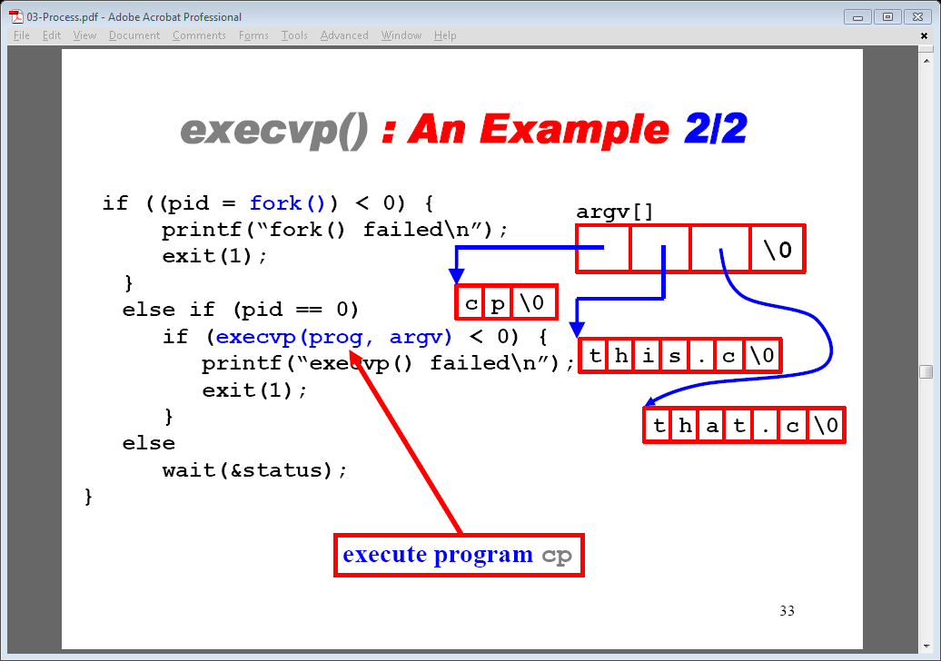
Example with fork(), exec() and wait()
Refer to execvp.c program; remove wait command and see what happened: explain what is happening

Slide 53
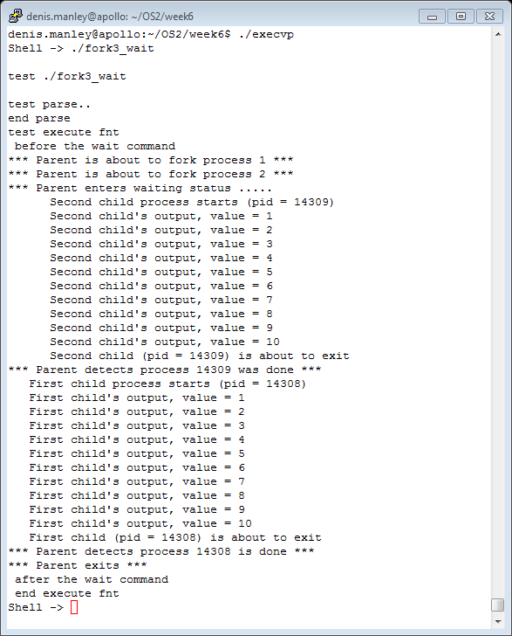
Sample output execvp.c: it uses exec() to run the program fork3_wait.c

Slide 54
Function heading
In the execvp function we have:
int execvp(char *prog, char *argv[])
These should not be confused with the
int main (int argc, char *argv[]).
The arguments in main refer to command line arguments:
argc is the number of command line arguments
Argv is an array of strings corresponing to the command line arguments: n.b. The program name is also a command line argument

Slide 55
Homework Exercise
Compile and Run fork1.c, fork2.c and fork3.c 5 times and note and differences in the output.
Compile and Run fork4.c and explain the output
Modify the fork_3.c question so that it checks if there is only three command line argument.
The second command line argument is displayed in the child process
The third command line argument is displayed in the parent process

Slide 56
Sample Questions
Briefly describe the elements of a PCB (4 marks)
Explain the steps a process can undergo as through the job and process scheduler. (8 marks)
Describe the process of context switching as it applies to process control blocks (PCB). (5 marks)
In linux a process is created using the fork() command. Explain the steps that occur if a fork() command is called (8 marks)

Slide 57
Sample Question
The wait () command is another important associated with processes: Explain, using a suitable example, exactly how the wait functions works (10 marks).
The execvp command has the following format:
int execvp(char *prog, char *argv[])
Explain what values are stored in the prog and the argv parameters if the two command line argument are: gcc and file1.c (4 marks)
Explain how the following code using a combination of the fork(), wait() and exec() command can be used to run new processes. (12 marks)

Slide 58
Sample Question
if ((pid = fork()) < 0) { /* fork a child process */
printf("*** ERROR: forking child process failed\n");
exit(42);
}
else if (pid == 0) { /* for the child process: */
if (execvp(*argv, argv) < 0) { /* execute the command */
printf("*** ERROR: exec failed\n");
exit(1);
}
}
else { /* for the parent: */
while (wait(&status) != pid) /* wait for completion */
;
}

